Slide 1
Fault Detection Example: Ridge Crest Lidar
Maddie Schwarz 11/3/20

Slide 2
Content
Testing of fault detection workflow using 0.5m Ridge Crest Lidar
https://portal.opentopography.org/datasetMetadata?otCollectionID=OT.012020.32611.1
Workflow used: DEM-→ Weighed Overlay → Segmentation
Showcases small portion of mapped Ridge Crest Rupture & compares to mapped faults from DuRoss 2019
https://www.sciencebase.gov/catalog/item/5e7e79afe4b01d50927718a1
(More examples coming soon)

Slide 3
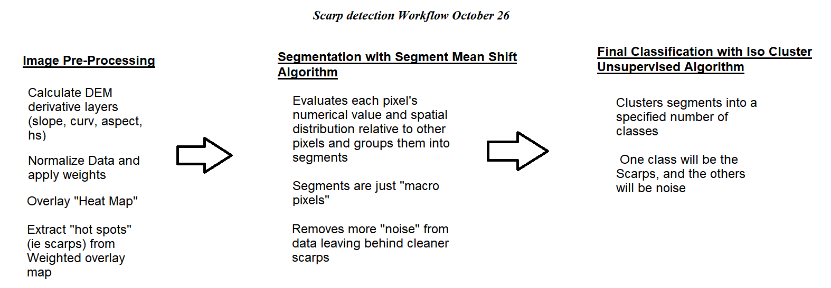
Workflow Used in ArcGIS

Slide 4
Results
Success using only the unsupervised Segment Mean shift Algorithm in ArcGIS
Note: Algorithm in shown examples worked with very small portion of data
very likely it would mis-identify roads as scarps if roads were included in assessed area
Aspect less important in RC data than 2m Iceland Data
Variance of Aspect not used in overlay (not useful, unlike in Iceland)
Higher res data poses new problems: more detail = more noise (ex: trees) & scarps more segmented (sometimes harder for algorithm to distinguish)
Strike slip faults with little surface expression not detected very well

Slide 5
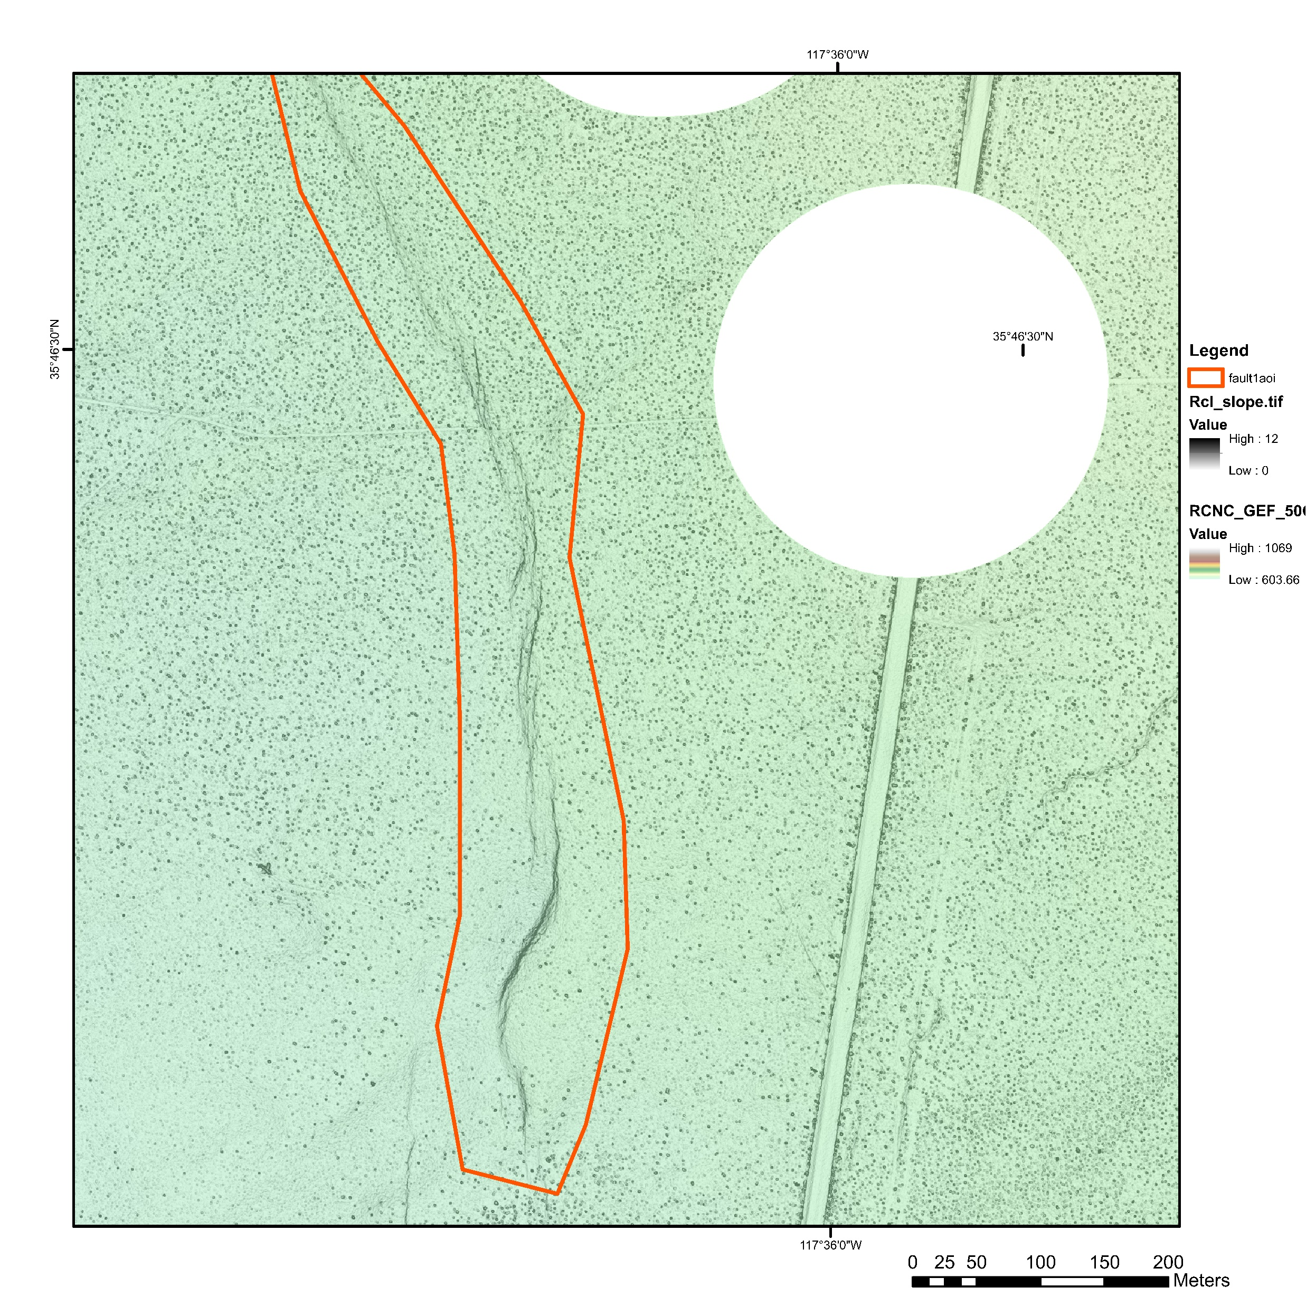
Slope map with overlaying colorshade DEM;
Area assessed by algorithm outlined in red
Area assessed by Algorithm
Slope (Reclassified; 12 = ~80 degrees;)
Elevation (m)

Slide 6
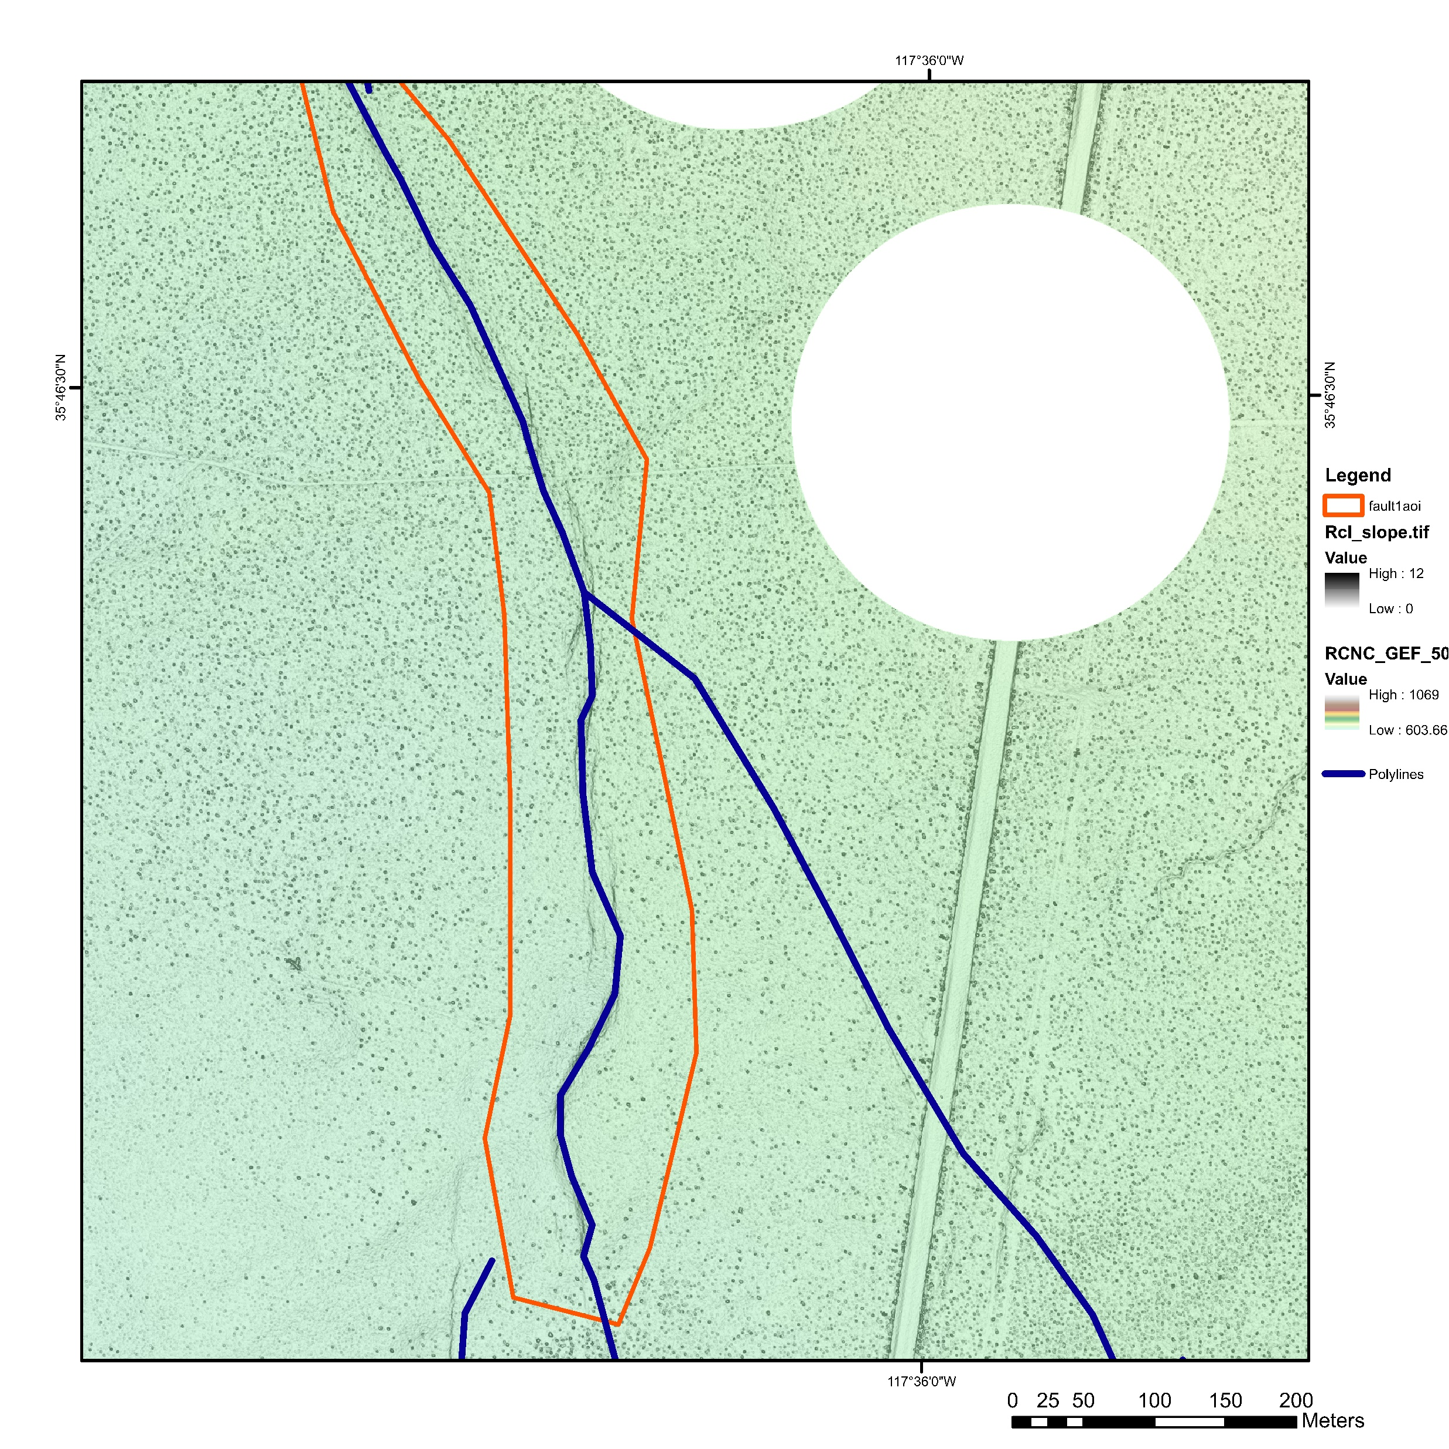
Area assessed by Algorithm
Slope (Reclassified; 12 = ~80 degrees;)
Elevation (m)
DuRoss Rupture Trace

Slide 7
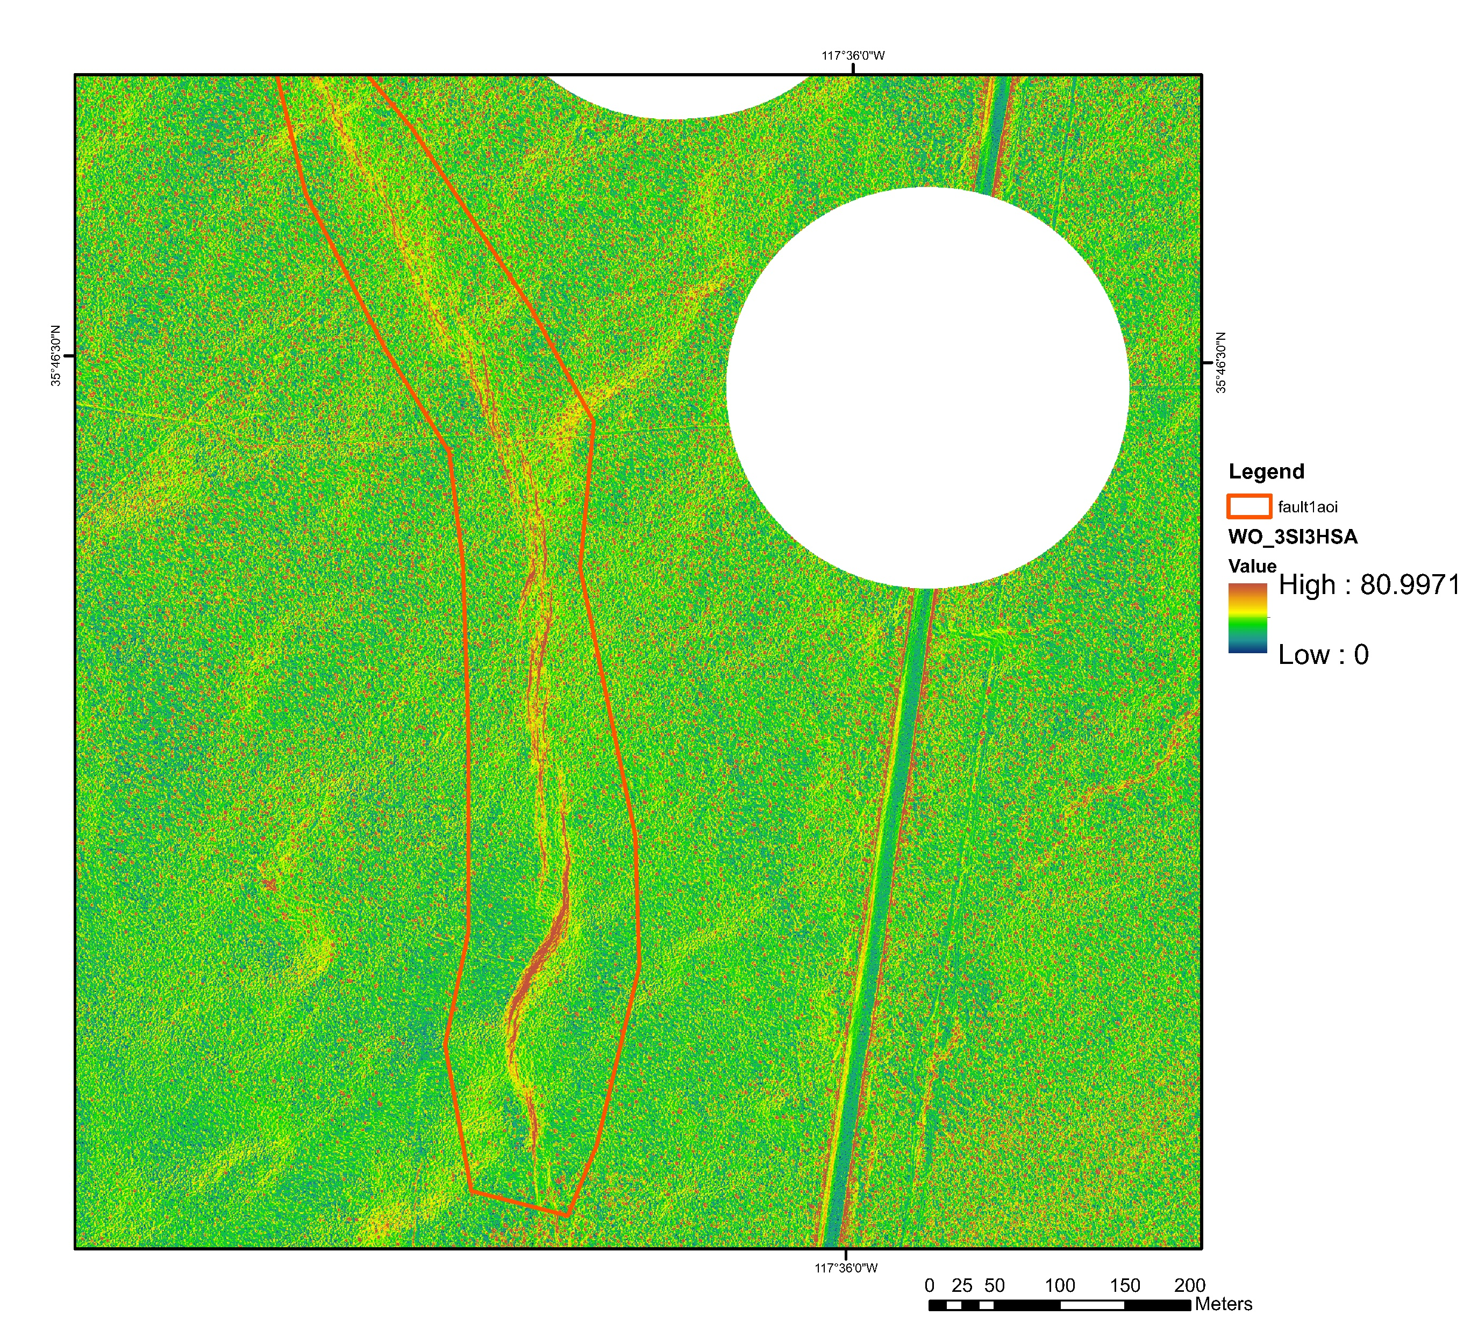
Weighted Overlay Map from Slope, Hillshade, and Aspect Red = features most “scarp-like” based on datasets mentioned above Slope given and HS given weights of 3; aspect given weight of 1
Area assessed by Algorithm
Weighted Overlay (not scarp vs Scarp-like pixels)
Notice portion of fault mapped by DuRoss not showing up in WO (so not assessed by algorithm in this run)

Slide 8
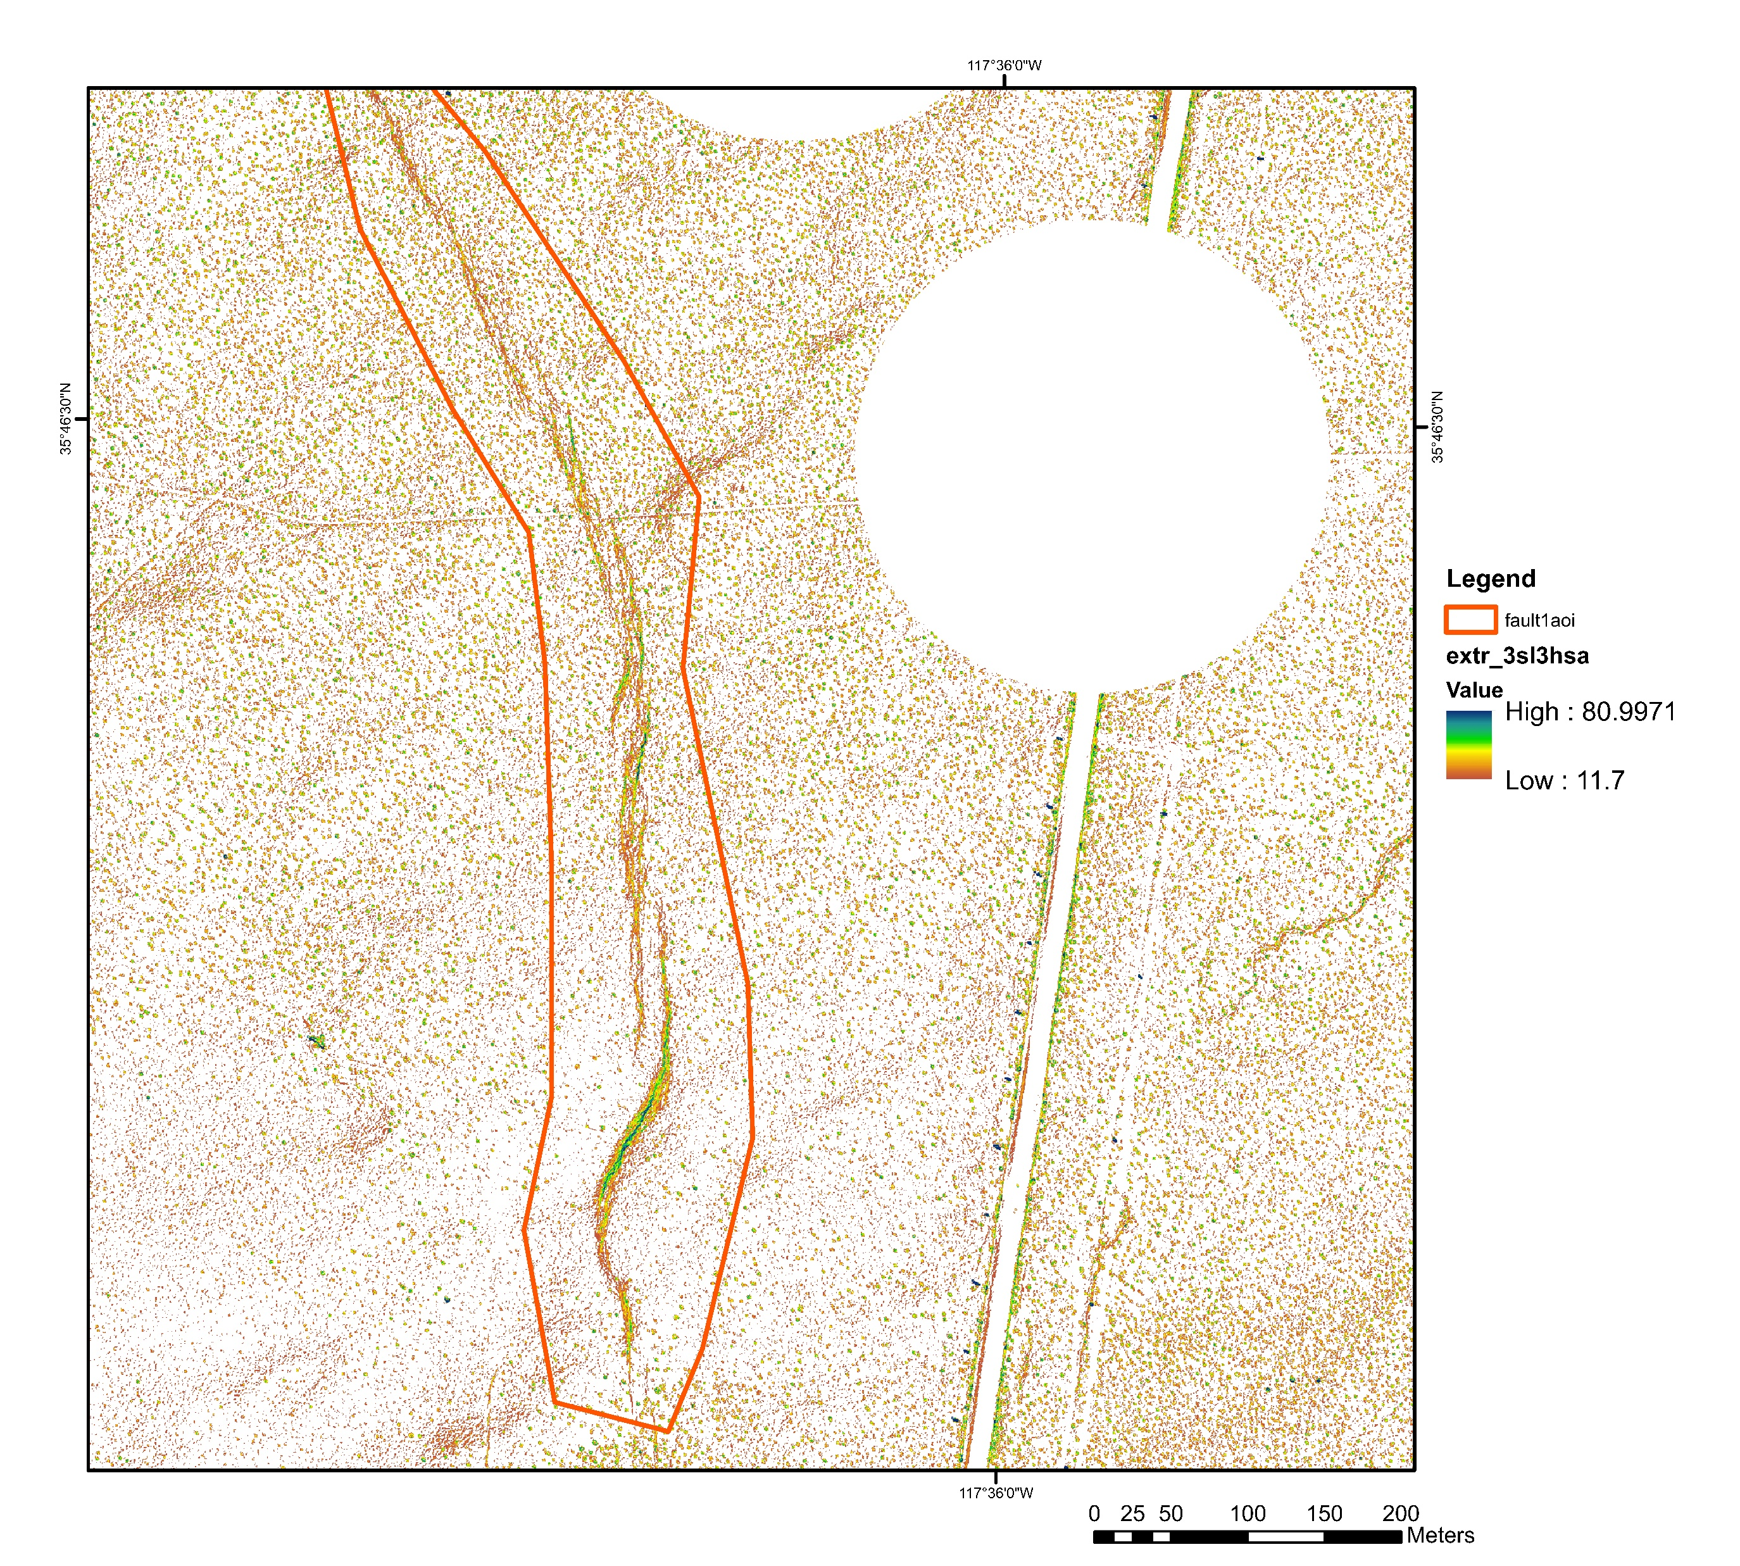
Extracted Weighted Overlay values of most “scarp-like” features
(values >11.7 score)
Area assessed by Algorithm
Weighted Overlay (not scarp vs Scarp-like pixels)

Slide 9
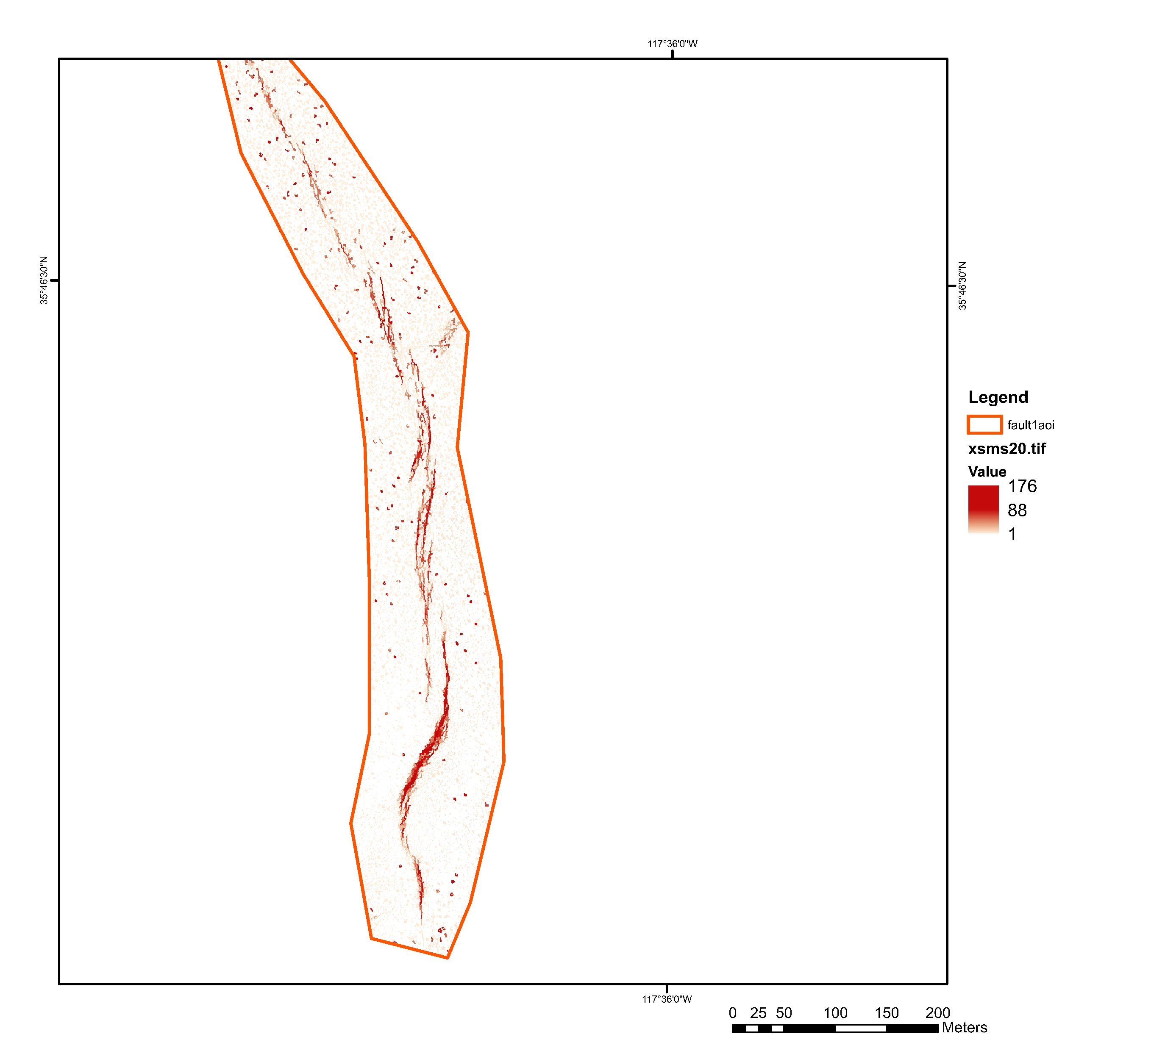
Segmentation algorithm output
Highest values = Most likely to be a scarp
Lowest values = not a scarp, but have similar spectral characteristics
Noise from trees; Some Missing Segments of scarps
Area assessed by Algorithm
Segment Mean Shift algorithm score

Slide 10
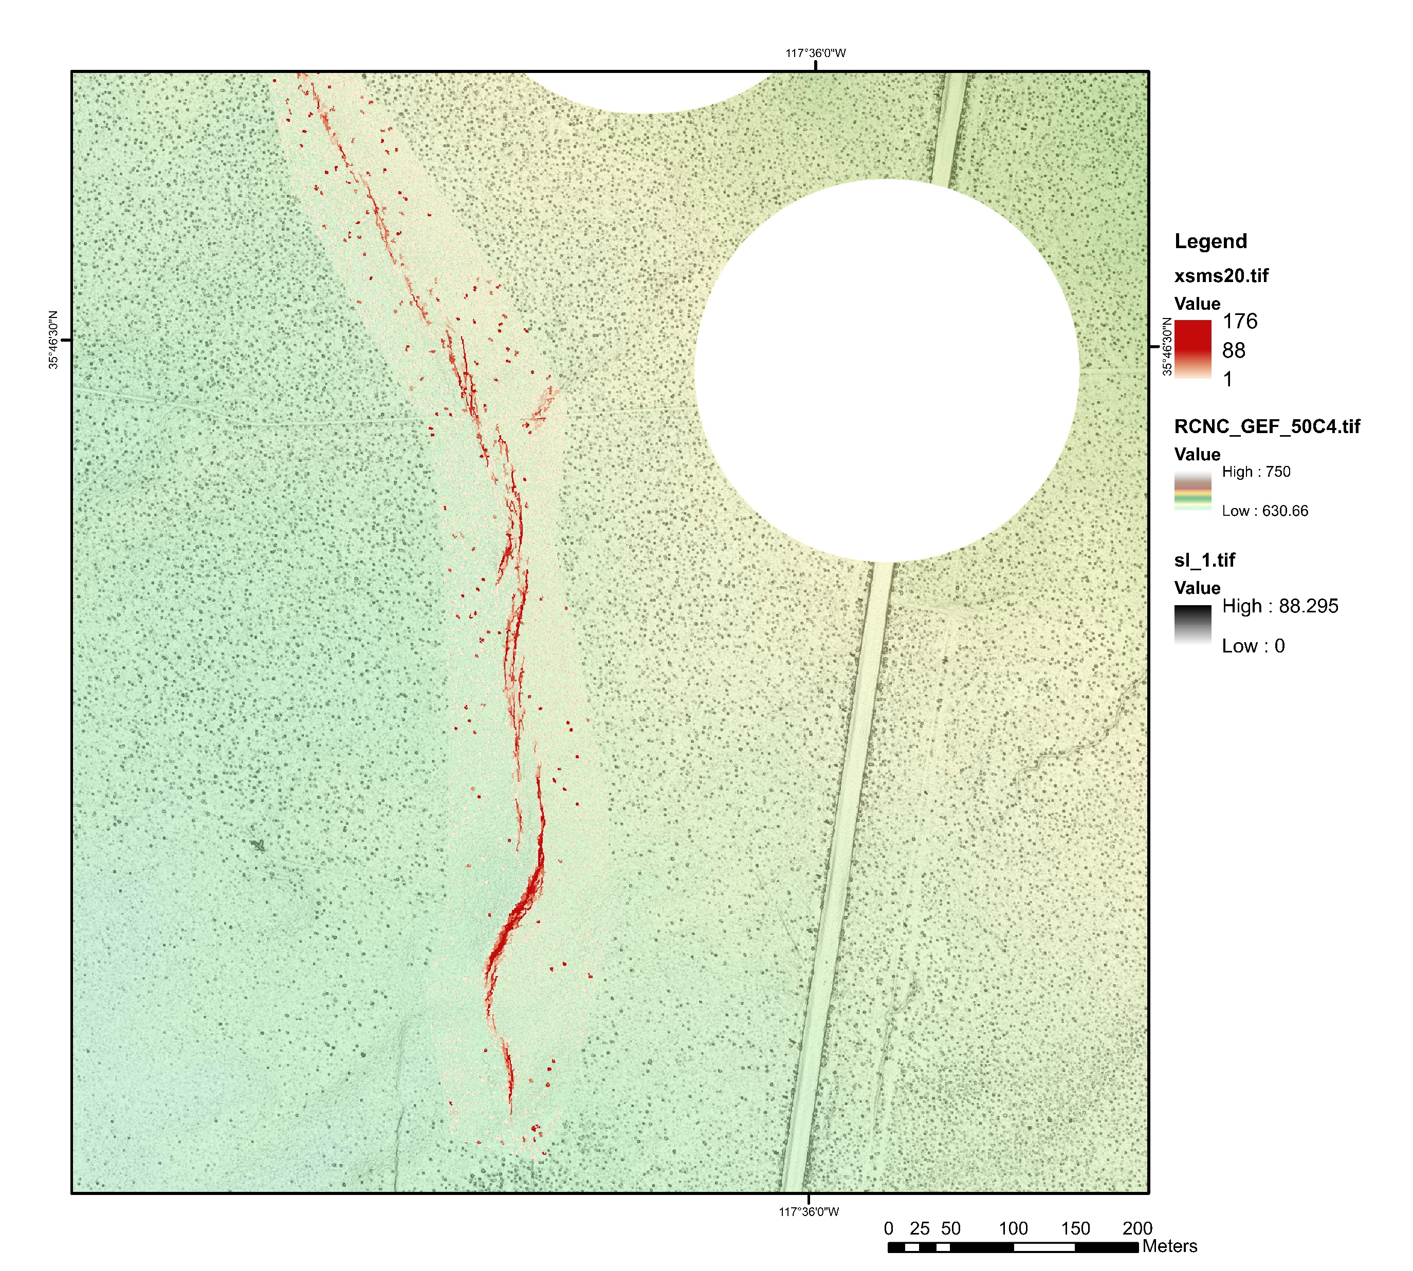
Segment Mean Shift algorithm score
Elevation (m)
Slope (degrees)

